Slide 1
Iberia
NDC Newsletter
2023 APRIL

Slide 2
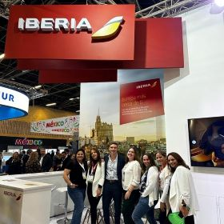
¡Hola!
APRIL 2023
IB NDC keeps growing! We have recently added Senegal as a new country available in NDC. From now on, Travel Agencies in this market will be able to access the exclusive IB NDC content and Iberia's best offers.
We have also held meetings with several Spanish Travel Agencies Associations to present NDC new features and functionalities, with special focus on travel needs for corporate traffic. At the BTL Fair in Lisbon we held meetings with Travel Agencies and Service Providers in order to help us increase our presence in our neighbouring country.
In terms of new direct connections, we welcome two new aggregators: Ideas Fractal, Service Provider with a strong influence in Latin American markets and Verteil with coverage in Asian markets.
Welcome both on board!

Slide 3
Points of contact
From our Call Centers we offer you a better service
.
Call Centre for Spain:
24 hours a day, 7 days a week
in English and Spanish.
91 9046 357
For other markets call the usual Agency Call Centre (check the number for your country on Iberiagencias.com) and select the NDC option on the voice mail.
At LATAM we have extended the NDC Call Centre hours to Saturdays and Sundays from 9:00 am to 6:00 pm.

Slide 4
Connecting Options
Freedom of choice is important,
so, you choose how to connect to either
Iberia or BA NDC Services.
A
Direct Connections
B
C
Through IAG Portals
Through an aggregator or service provider
To develop your own connection directly to our Iberia API, follow this steps:
Visit developer.iairgroup.com/... to create your Mashery User ID.
Submit your Registration Form selecting “Pre-Live Plan” to access our Sandbox.
To develop a direct connection to British Airways API, go to:ndc.ba.com
To connect through the services of an Aggregator / Technology Provider that is already certified with Iberia, please visit:
Register to access NDC through third parties to submit your registration form.
For a list of Aggregators/technology providers already certified with Iberia, please see Appendix I.
For information on technology providers connecting to British Airways, please visit: ndc.ba.com
IAG offers a free alternative to access NDC content through a Travel Agency Web Portal. To do so:
Complete the NDC Login Registration to submit your registration form by selecting JRTechnologies.
If you already have an NDC connection and want to access the Portal, register here. agencyportal.iag.cloud/register
Check with your Iberia or British Airways account manager to find out if the IAG portal is available in your market.

Slide 5
NDC Functionalities
Shopping
Search for Iberia fares and offers
Search:
Public fares, including APPs (additional fares)
Private holiday fares such as VFR or Tour Operation.
Private corporate fares, including APPs (except JBA routes).
Seat Only fares for authorized agencies.
Ask for the cheapest rate by combining different families.
Includes multiple passengers and multiple passenger types (adult, child, infant) on journeys
OW, RT, Multicity and Open Jaw.
Apply for discounts for:
Residents
(available only for the Spanish market).
Use your Iberia Plus frequent flyer number to receive the benefits associated with your tier level and earn AVIOS.
Enter the FFs of oneworld carriers and OnBusines programme only for earning points.
Large families
(available only for the Spanish market).

Slide 6
NDC Functionalities
Ordering
Create your booking and issue tickets
Creation of reservations
with instant purchase and issuance.
Creation of on-hold reservations to be issued later.
Purchase of luggage (up to 9 pieces for 15, 23 and/or 32Kgs) and/or selection of paid seats (for instant payment only).
Accepted forms of payment:
BSP/ARC Cash (with BSP reporting and settlement, including basic commissions).
Credit card (Visa, Mastercard, Amex, Dinners, UATP and ELO in Brazil). Reported to BSP/ARC for information.
Installment payments in Latin American markets.
Iberia Vouchers & Voucher+Cash*
(*except US and PR markets).
Inclusion of mandatory special services (SSR) as WCHR.
Add contact information:
Passenger email and telephone number: for operational notifications and emergency contact.
Agency email for involuntary change notifications.
You are allowed to choose who receives the e-mails - the agency, the customer, or both, and whether to send only the itinerary or itinerary plus price.
Use up to 30 characters to add a comment in the reservation for internal use and for cross-reference purposes.

Slide 7
NDC Functionalities
Servicing
Manage your bookings
Obtén los detalles de la reserva a través de OrderRetrieve.
Obtén una lista de reservas activas utilizando OrderList.
Cambios voluntarios (antes y/o después de la emisión):
Agrega maletas adicionales y/o asientos de a una reserva existente.
Corrección de nombre tras la emisión (hasta 3 caracteres) gratis.
Cancela a todos o a algunos pasajeros en un reserva multi-pasajero.
Cancela reservas sin volar o parcialmente utilizadas.
Cambia de vuelo, fecha y clase con:
- Emisión de EMD por el valor residual.
- Cargo del sobrecoste adicional.
Haz Split y cambia (Vuelo, Fecha y Clase) para algunos pasajeros en una reserva.
Agrega o modifica la información de contacto del Pasajero o Agencia/Seller.
Cambio de fecha/hora antes de la emisión de la reserva.
Cambio de Ruta: cambio de Aeropuerto dentro de la misma cuidad o cambio del número de segmentos en una misma ruta.
Se mantienen los Servicios Especiales incluidos en la reserva después del cambio.
Cambia múltiples veces.
Los cambios involuntarios de itinerario se informarán a la Agencia y al pasajero por correo electrónico.
Voluntary changes (before and/or after issuing, even having flown a segment
Involuntary itinerary changes will be reported to the Agency and to the passenger by email.
Name Correction (up to 3 characters) for free.
Changing of Flight, Date and Class/Cabin
Cancel and refund/void all passengers of a booking in 1 single step.
Split to Cancel and refund/void for some passengers in a booking multi-pax or to make a change in one of the pax .
Cancel unused and partially used Orders.
Route Modification: change airport within the same city or change number of segments in a same route
Special Services will remain in the booking after the change.
Multiple Changes are allowed.
Changes of FF or Onbusiness number.
Add extra bags (up to 9 pieces 23 kgs) and/or paid seats
to an existing Order (only after issuing TKT).
And now we also report involuntary changes via OCN (OrderChangeNotification).

Slide 8
More information
.
Got a question regarding our NDC? Contact your Iberia Account Manager or send us an e-mail to:
New.Distribution@iberia.es
For further technical information on our services please visit our developer web site at
IB NDC Docs Overview
For information on our partner
British Airways’ NDC,
please check it out at:
ndc.ba.com

Slide 9
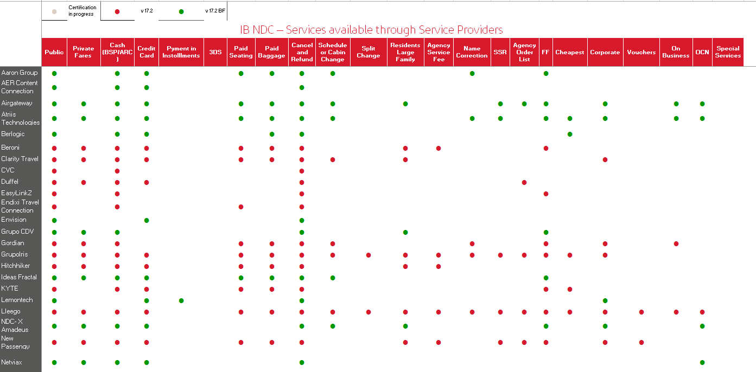
Service Providers IB NDC - Appendix I

Slide 10
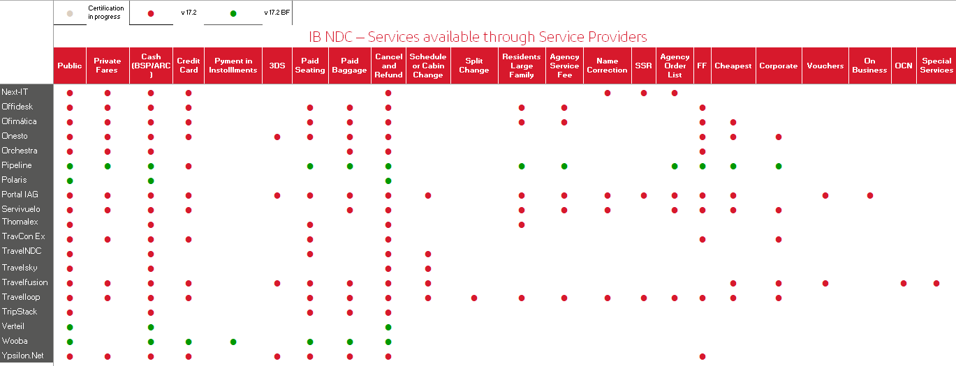
Service Providers IB NDC - Appendix I

Slide 11
Thank you!
Don't think twice. If you have not yet registered in the Iberia NDC, now you have the opportunity to do so and offer your customers all the news, offers and services that you will have available once you are registered.

