Slide 1
Iberia
NDC Newsletter
2023 MAY

Slide 2
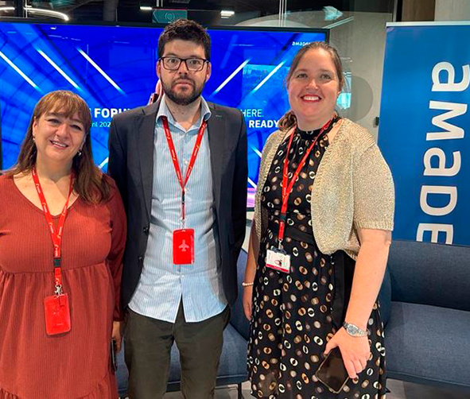
¡Hola!
MAY 2023
Last 20th of April IB NDC participated as a panelist in Amadeus NDC-X Forum held in Madrid where we had the chance to share with Travel Agencies and other Airlines all news and improvements with regards to distribution sponsored by Amadeus NDC-X who presented their NDC news.
We have launched two new functionalities, Upselling and Combinability of all fares families available are now available in NDC. These new capabilities improves and enlarges our offer to Travel Agencies using our NDC.
IAG Portal has implemented Muliticity and Stopover options improving offer possibilities to clients. These new capabilities are now available for Travel Agencies connected to the IAG Portal and they´d be able to enlarge the travel options when accessing IB NDC content through the IAG Portal.

Slide 3
Connection Options
Freedom of choice is important,
so, you choose how to connect to either
Iberia or BA NDC Services.
A
Direct Connections
B
C
Through IAG Portal
Through an aggregator or service provider
To develop your own connection directly to our Iberia API, follow these steps:
Visit Mashery Username. to create your Mashery User ID.
Submit the Registration Form selecting Direct, full fill your data and select “Pre-Live Plan” to get access to our Sandbox.
For more information regarding IB NDC API please visit IB NDC API Documentation
To develop a direct connection to British Airways API, go to:ndc.ba.com
To connect through the services of an Aggregator / Technology Provider that is already certified with Iberia:
Send the Registration Form selecting via thir-party Service Provider connection, full fill and submit the form.
For a list of Aggregators/technology providers already certified with Iberia, see next slide.
For information on technology providers connecting to British Airways, please visit: ndc.ba.com
IAG offers a free alternative to access NDC content through a Travel Agency Web Portal. For IB it´s available only for Leisure segment.
Send the Registration Form selecting IAG Portal as Service Provider
After registration register here your Agency and users agencyportal.iag.cloud/register
Check with your Iberia or British Airways account manager to find out if the IAG portal is available in your market.

Slide 4
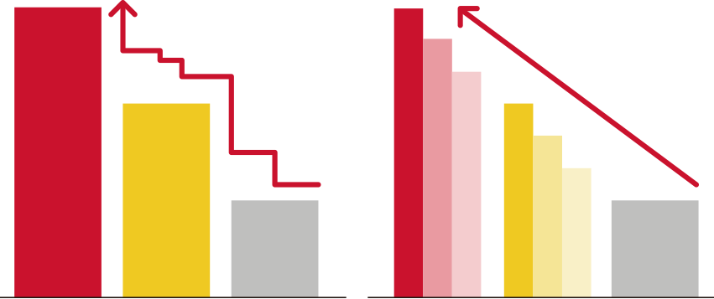
Content differentiation
Using Iberia NDC, Travel Agencies may have access to differential prices and content. It is thanks to the power of this new distribution channel that we can provide more flexibility and capabilities to our clients and adapt our products to match our common customers’ needs.
Additional Price Points
No DTC
Ancillaries
NON NDC
NDC
9 bag pieces
15, 23 and 32 kg Baggs
Priority Boarding
Payment with Voucher IB
SOLD OUT
SOLD OUT
TKTL
Final Price commitment
Tarifa 3
Tarifa 2
Tarifa 1
T3
T3’
T3’’
T2
T2’
T2’’
Tarifa 1
NDC-Only Net Fare Products
NDC exclusive offers
Cool-off period
No ADMs

Slide 5
NDC Capabilities
Shopping
Search for Iberia fares and offers
Search:
Public fares, including APPs (additional fares)
Private holiday fares such as VFR or Tour Operation.
Private corporate fares, including APPs (except JBA routes).
Seat Only fares for authorized agencies.
Includes multiple passengers and multiple passenger types (adult, child, infant) on journeys
OW, RT, Multicity and Open Jaw.
IB Prime Flights , CodeShare and Intermodality (Bus and Train only in spain)
Upselling offers combining all fare families.
In addition, ask for the cheapest fate result of combining different families.
Apply for discounts for:
Residents
(available only for the Spanish market).
Use your Iberia Plus frequent flyer number to receive the benefits associated with your tier level and earn AVIOS.
Enter the FFs of oneworld carriers and OnBusines programme only for earning points.
Large families
(available only for the Spanish market).

Slide 6
NDC Capabilities
Ordering
Create your booking and issue tickets
Create instant purchase bookings and on-hold to issue later
Purchase Priority Boarding regardless the Group pre-assigned to board
Purchase of luggage (up to 9 pieces for 15, 23 and/or 32Kgs) and/or selection of paid seats (for instant payment only).
Accepted forms of payment:
BSP/ARC Cash (with BSP reporting and settlement, including basic commissions).
Credit card (Visa, Mastercard, Amex, Dinners, UATP and ELO in Brazil). Reported to BSP/ARC for information.
Installment payments in Latin American markets.
Iberia Vouchers and Vouchers+Cash
(*except US and PR markets).
Add mandatory special services (SSR) as WCHR.
Add contact information:
Passenger email and telephone number: for operational notifications and emergency contact.
Agency email for involuntary change notifications.
You are allowed to choose who receives the e-mails - the agency, the customer, or both, and whether to send only the itinerary or itinerary plus price.
Use up to 30 characters to add a remark for internal use and for cross-reference purposes.

Slide 7
NDC Capabilities
Servicing
Manage your bookings
Obtén los detalles de la reserva a través de OrderRetrieve.
Obtén una lista de reservas activas utilizando OrderList.
Cambios voluntarios (antes y/o después de la emisión):
Agrega maletas adicionales y/o asientos de a una reserva existente.
Corrección de nombre tras la emisión (hasta 3 caracteres) gratis.
Cancela a todos o a algunos pasajeros en un reserva multi-pasajero.
Cancela reservas sin volar o parcialmente utilizadas.
Cambia de vuelo, fecha y clase con:
- Emisión de EMD por el valor residual.
- Cargo del sobrecoste adicional.
Haz Split y cambia (Vuelo, Fecha y Clase) para algunos pasajeros en una reserva.
Agrega o modifica la información de contacto del Pasajero o Agencia/Seller.
Cambio de fecha/hora antes de la emisión de la reserva.
Cambio de Ruta: cambio de Aeropuerto dentro de la misma cuidad o cambio del número de segmentos en una misma ruta.
Se mantienen los Servicios Especiales incluidos en la reserva después del cambio.
Cambia múltiples veces.
Los cambios involuntarios de itinerario se informarán a la Agencia y al pasajero por correo electrónico.
Voluntary changes (before and/or after issuing and with a flown a segment.
Involuntary Changes:
Cancelation and Refund 100%
Will be informed to the Agency and to the passenger by email.
Name Correction (up to 3 characters) for free.
Changing of schedule, Date and/or Class/Cabin
Split:
to Cancel and refund/void one passengers
to change something in one of the pax
Route Change:
Airport within the same city
Change the number of segments in a same OnD
Changes of FF or Onbusiness number.
Changes in passeger contact information
Cancel and refund/void all passengers.
Add extra bags (up to 9 pieces 23 kgs) and/or paid seats
to an existing Order (only after issuing TKT).
And now we also Inform involuntary changes via OCN (OrderChangeNotification).

Slide 8
Support for Travel Agencies connected to NDC
Technical and Funcional Support (Direct Connections)
IB NDC Latest News
IB NDC Support for Travel Agencies
Travel Agencies can use IAG Portal as their Servicing Tool in case their Service Provider doesn´t provide yet the functionality you need.
For more information please visit :
Iberia NDC Support
Service Desk in JIRA.
https://id.atlassian.com/login
With your provided JIRA user.
Onboarding doubts at New.Distribution@iberia.es
For all NDC bookings an exclusive IB NDC Call Center is available:
Monthly Tarde Newsletter.
Exclusive Comms with new capabilities.
Visit Iberiagencias.com
Dialing your usual local Call Center number selecting NDC option from the touch-tone menu attended the same usual timetable.
In Spain for Spanish IATAs we have a dedicated number attended 24 hours, 7/7 both in Spanish and English.
91 9046 357
BA NDC Contacts
https://ndc.ba.com/

Slide 9
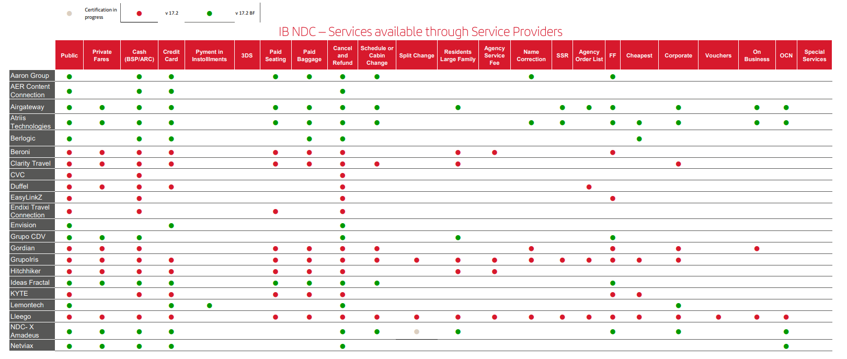
Service Providers IB NDC - Appendix I

Slide 10
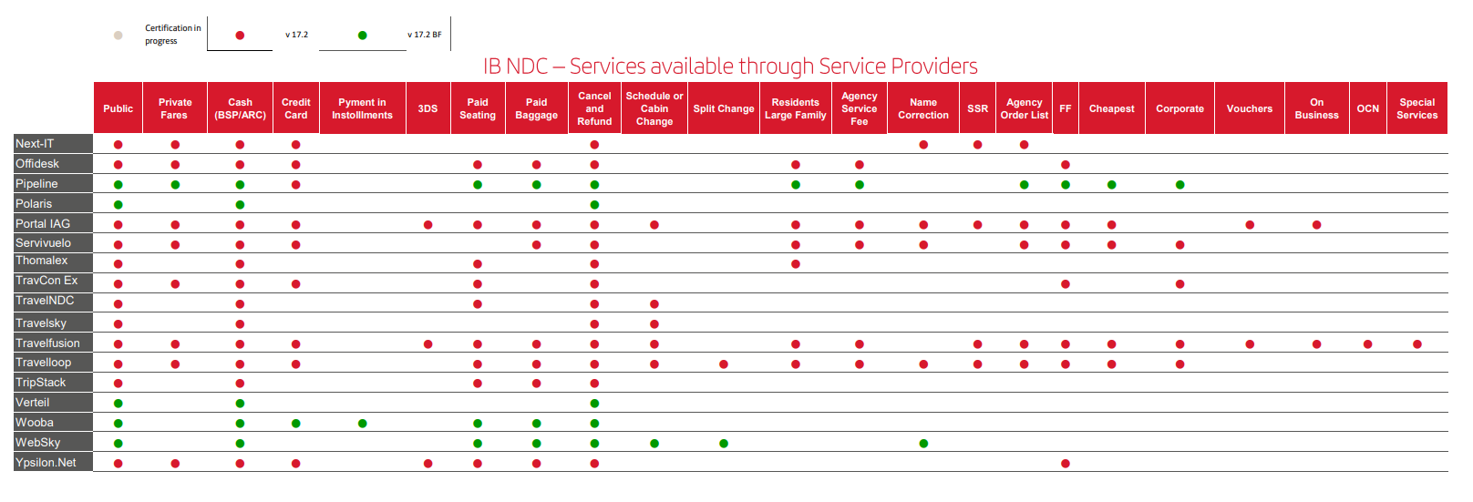
Service Providers IB NDC - Appendix I

Slide 11
Thank you!
Don't think twice. If you have not yet registered in the Iberia NDC, now you have the opportunity to do so and offer your customers all the news, offers and services that you will have available once you are registered.

