Slide 1


Iberia
NDC Newsletter
2023 December

Slide 2
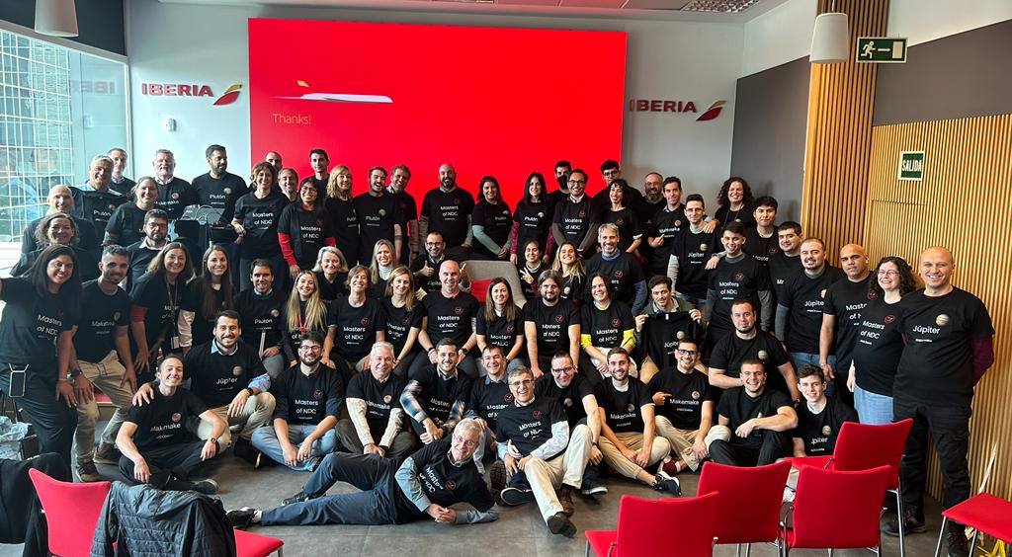




¡Hola!
December 2023
IB NDC ends 2023 with a steady and continued increase of the adoption, backed up by our partners and the improvements in our API NDC proposal.
This year we´ve welcomed 7 new partners and launched capabilities to improve our NDC proposal.
We have developed new capabilities such as the Up Selling, fare family combinability and Cancel and 100% refund in case of involuntary changes.
We have also increased our fare product catalog with Humanitarian, Marines, SPORT, and Hola Madrid fares on top of the Tour operation, VFR, Seat Only...
Ancillaries such as Priority Boarding, Special Equipment and additional bags of 15kgs and 32Kgs are now available only for your clients through NDC.
Thank you all for accompanying us in this travel, IB NDC Team

Slide 3

Connection Options
Freedom of choice is important,
so, you choose how to connect to either
Iberia or BA NDC Services.
A
Direct Connections
B
C
Through IAG Portal
Through an aggregator or service provider
To develop your own connection directly to our Iberia API, follow these steps:
  Visit Mashery Username. to create your Mashery User ID.
  Submit the Registration Form selecting Direct, full fill your data and select “Pre-Live Plan” to get access to our Sandbox.
  For more information regarding IB NDC API please visit IB NDC API Documentation
  To develop a direct connection to British Airways API, go to:ndc.ba.com
To connect through the services of an Aggregator / Technology Provider that is already certified with Iberia:
Send the Registration Form selecting via third-party Service Provider connection, full fill and submit the form.
For a list of Aggregators/technology providers already certified with Iberia, see next slide.
For information on technology providers connecting to British Airways, please visit: ndc.ba.com
IAG offers a free alternative to access NDC content through a Travel Agency Web Portal. For IB it´s available only for Leisure segment.
Send the Registration Form selecting IAG Portal as Service Provider
After registration register here your Agency and users agencyportal.iag.cloud/register
Check with your Iberia or British Airways account manager to find out if the IAG portal is available in your market.

Slide 4



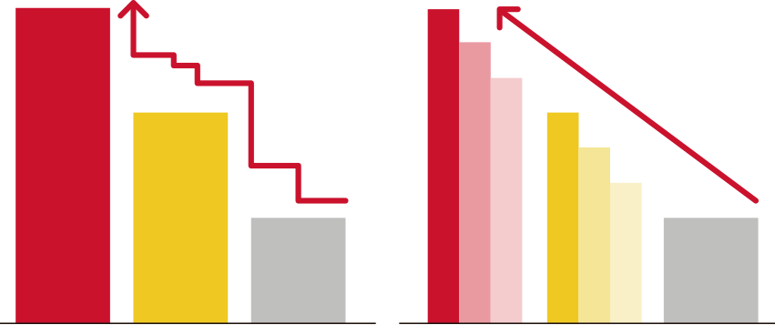








Content differentiation
Using Iberia NDC, Travel Agencies may have access to differential prices and content. It is thanks to the power of this new distribution channel that we can provide more flexibility and capabilities to our clients and adapt our products to match our common customers’ needs.
Ancillaries
Additional Price Points
No DTC
9 bag pieces
15, 23 and 32 kg Baggs
Priority Boarding
Sporting Equipment Golf, Bicycle, sky)
NON NDC
NDC
Payment with Voucher IB
SOLD OUT
SOLD OUT
TKTL
Final Price commitment
Tarifa 3
Tarifa 2
Tarifa 1
T3
T3’
T3’’
T2
T2’
T2’’
Tarifa 1
NDC-Only Net Fare Products
NDC exclusive offers
Cool-off period
No ADMs

Slide 5






NDC Capabilities
Shopping
Search for Iberia fares and offers
Search:
Public fares, including APPs (additional fares)
Private holiday fares such as VFR or Tour Operation, Sport, Entertainment, Humanitarian, Marines…
Private corporate fares, including APPs
Seat Only fares for authorized agencies.
Add multiple passengers and multiple passenger types (adult, child, infant) on different journey types
OW, RT, Multicity and Open Jaw.
IB Prime Flights , Codeshare and Intramodality (Bus and Train only in Spain)
Upselling offers combining all fare families.
In addition, ask for the cheapest fate result of combining different families.
With a Spanish IATA apply for discounts for:
Residents
(available only for the Spanish market).
Large families
(available only for the Spanish market).
Use your client Iberia Plus frequent flyer number to receive the benefits associated with your tier level and earn AVIOS.
Enter your client oneworld carriers FFs and OnBusines programme for earning points.

Slide 6







NDC Capabilities
Ordering
Create your booking and issue tickets
Create instant purchase bookings and on-hold to issue later
Add free seats to a on-hold booking
Purchase Priority Boarding and
Special Baggage
Purchase of luggage (up to 9 pieces for 15, 23 and/or 32Kgs) and/or selection of paid seats (for instant payment only).
Accepted forms of payment:
BSP/ARC Cash (with BSP reporting and settlement, including basic commissions).
Credit card (Visa, Mastercard, Amex, Dinners, UATP and ELO in Brazil). Sales reported to BSP/ARC for information.
Installment payments in Latin American markets.
Iberia Vouchers and Vouchers+Cash
(*except US and PR markets).
Add mandatory special services (SSR) as WCHR.
  Add contact information:
  Passenger email and telephone number: for operational notifications and emergency contact.
  Agency email for involuntary change notifications.
  You are allowed to choose who receives the e-mails - the agency, the customer, or both, and whether to send only the itinerary or itinerary plus price.
Use up to 30 characters to add a remark for internal use and for cross-reference purposes.

Slide 7



NDC Capabilities
Servicing
Manage your bookings
Obtén los detalles de la reserva a través de OrderRetrieve.
Obtén una lista de reservas activas utilizando OrderList.
Cambios voluntarios (antes y/o después de la emisión):
  Agrega maletas adicionales y/o asientos de a una reserva existente.
  Corrección de nombre tras la emisión (hasta 3 caracteres) gratis.
  Cancela a todos o a algunos pasajeros en un reserva multi-pasajero.
  Cancela reservas sin volar o parcialmente utilizadas.
  Cambia de vuelo, fecha y clase con:
- Emisión de EMD por el valor residual.
- Cargo del sobrecoste adicional.
  Haz Split y cambia (Vuelo, Fecha y Clase) para algunos pasajeros en una reserva.
  Agrega o modifica la información de contacto del Pasajero o Agencia/Seller.
  Cambio de fecha/hora antes de la emisión de la reserva.
  Cambio de Ruta: cambio de Aeropuerto dentro de la misma cuidad o cambio del número de segmentos en una misma ruta.
Se mantienen los Servicios Especiales incluidos en la reserva después del cambio.
Cambia múltiples veces.
Los cambios involuntarios de itinerario se informarán a la Agencia y al pasajero por correo electrónico.
Voluntary changes (before and/or after issuing and with a flown a segment.
Involuntary Changes:
Will be informed to the Agency and to the passenger by email.
Cancelation and Refund 100%
Name Correction (up to 3 characters) for free.
Changing of schedule, Date and/or Class/Cabin
Split:
  to Cancel and refund/void one passengers
  to change something in one of the pax
Route Change:
  Airport within the same city
  Change the number of segments in a same OnD
Changes of FF or Onbusiness number.
Changes in passenger contact information
Cancel and refund/void all passengers.
Add extra bags (up to 9 pieces 23 kgs) and/or paid seats
to an existing Order
(only after issuing TKT).
And now we also Inform involuntary changes via OCN (OrderChangeNotification).

Slide 8






Support for Travel Agencies connected to NDC
Technical and Funcional Support (Direct Connections)
IB NDC Latest News
IB NDC Support for Travel Agencies
Travel Agencies can use IAG Portal as their Servicing Tool in case their Service Provider doesn´t provide yet the functionality you need.
For more information please visit :
Iberia NDC Support
Service Desk in JIRA.
https://id.atlassian.com/login
With your provided JIRA user.
Onboarding doubts at IBNDC.Onboarding@iberia.es
For all NDC bookings an exclusive IB NDC Call Center is available:
Monthly Tarde Newsletter.
Exclusive Comms with new capabilities.
Visit Iberiagencias.com
Dialing your usual local Call Center number selecting NDC option from the touch-tone menu attended the regular business hours now extended from Monday to Sunday.
In Spain for Spanish IATAs we have a dedicated number attended 24 hours, 7/7 both in Spanish and English.
91 9046 357
BA NDC Contacts
https://ndc.ba.com/

Slide 9
Service Providers IB NDC - Appendix I

Slide 10
Service Providers IB NDC - Appendix I

Slide 11


Thank you!
Don't think twice. If you have not yet registered in the Iberia NDC, now you have the opportunity to do so and offer your customers all the news, offers and services that you will have available once you are registered.

