Slide 1
Iberia
NDC Newsletter Trade
2023 JUNE

Slide 2
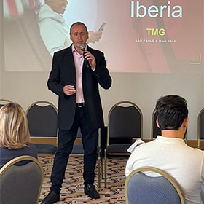
¡Hola!
JUNE 2023
In May we met with the main Travel Associations in Spain where we exchanged impressions, shared our news and future plans to continue growing and improving our NDC content.
In Latin America we travelled to Brazil and Argentina where interest in NDC is growing. In Brazil we participated in the event organised by Grupo TMG, Travel Manager Group, where we presented our NDC proposal and took part in a panel together with other airlines, TMCs and OBTs where we answered questions from the attendees.
In Argentina we have held individual meetings with Travel Agencies that are already starting to change their distribution model.
This month we welcome WebSky Tech as a new Service Provider. Together we will be offering NDC content to Travel Agencies with all the benefits and advantages available through NDC in more than 30 countries.

Slide 3
Connecting Options
Freedom of choice is important,
so you choose how to connect to either
Iberia or BA NDC Services.
A
Direct Connections
B
C
Through IAG Portals
Through an aggregator or service provider
To develop your own connection directly to our Iberia API follow this steps:
Visit developer.iairgroup.com/... to create your Mashery User ID.
Submit your Registration Form selecting “Pre-Live Plan” to access our Sandbox.
To develop a direct connection to British Airways API, go to:ndc.ba.com
To connect through the services of an Aggregator / Technology Provider that is already certified with Iberia, please visit:
NDC Registration via Third Party to submit your registration form.
To check Aggregators/technology providers already certified with Iberia, please see Appendix I at
For information on technology providers connecting to British Airways, please visit: ndc.ba.com
IAG offers a free alternative to access NDC content through a Travel Agency Web Portal. To do so:
Complete the NDC Login Registration to submit your registration form by selecting JRTechnologies.
If you already have an NDC connection and want to access the Portal, register here. IAG Portal Registration
Check with your Iberia or British Airways account manager to find out if the IAG portal is available in your market.

Slide 4
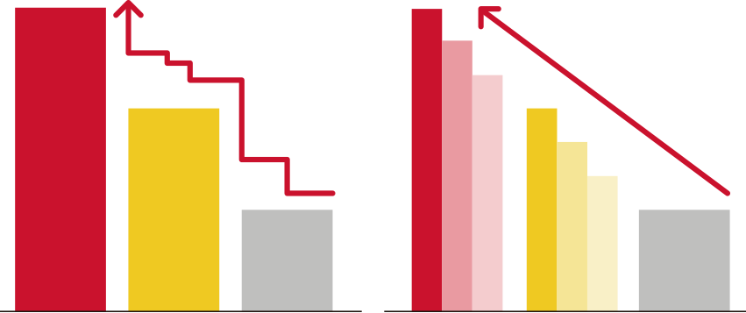
Content differentiation
Using Iberia NDC, Travel Agencies may have access to differential prices and content. It is thanks to the power of this new distribution channel that we can provide more flexibility and capabilities to our clients and adapt our products to match our common customers’ needs.
Additional Price Points
No DTC
Ancillaries
NON NDC
NDC
9 bag pieces
15, 23 and 32 kg Baggs
Priority Boarding
Payment with Voucher IB
SOLD OUT
SOLD OUT
TKTL
Final Price commitment
Tarifa 3
Tarifa 2
Tarifa 1
T3
T3’
T3’’
T2
T2’
T2’’
Tarifa 1
NDC-Only Net Fare Products
NDC exclusive offers
Cool-off period
No ADMs

Slide 5
NDC Functionalities
Shopping
Search for Iberia fares and offers
Search:
Public fares, including APPs (additional fares)
Private holiday fares such as VFR or Tour Operation.
Private corporate fares, including APPs (except JBA routes).
Seat Only fares for authorized agencies.
Upselling offers combining all fare families.
In addition, ask for the cheapest fare result of combining different families.
Includes multiple passengers and multiple passenger types (adult, child, infant) on journeys
OW, RT, Multicity and Open Jaw.
Apply for discounts for:
Residents
(available only for the Spanish market).
Use your Iberia Plus frequent flyer number to receive the benefits associated with your tier level and earn AVIOS.
Enter the FFs of oneworld carriers and OnBusines programme only for earning points.
Large families
(available only for the Spanish market).

Slide 6
NDC Functionalities
Ordering
Create your booking and issue tickets
Creation of reservations
with instant purchase and issuance.
Creation of on-hold reservations to be issued later.
Purchase of luggage (up to 9 pieces for 15, 23 and/or 32Kgs) and/or selection of paid seats (for instant payment only).
Accepted forms of payment:
BSP/ARC Cash (with BSP reporting and settlement, including basic commissions).
Credit card (Visa, Mastercard, Amex, Dinners, UATP and ELO in Brazil). Reported to BSP/ARC for information.
Installment payments in Latin American markets.
Iberia Voucher and Voucher+Cash
(*except US and PR markets).
Inclusion of mandatory special services (SSR) as WCHR.
Add contact information:
Passenger email and telephone number: for operational notifications and emergency contact.
Agency email for involuntary change notifications.
You are allowed to choose who receives the e-mails - the agency, the customer, or both, and whether to send only the itinerary or itinerary plus price.
Use up to 30 characters to add a comment in the reservation for internal use and for cross-reference purposes.

Slide 7
NDC Functionalities
Servicing
Manage your bookings
Obtén los detalles de la reserva a través de OrderRetrieve.
Obtén una lista de reservas activas utilizando OrderList.
Cambios voluntarios (antes y/o después de la emisión):
Agrega maletas adicionales y/o asientos de a una reserva existente.
Corrección de nombre tras la emisión (hasta 3 caracteres) gratis.
Cancela a todos o a algunos pasajeros en un reserva multi-pasajero.
Cancela reservas sin volar o parcialmente utilizadas.
Cambia de vuelo, fecha y clase con:
- Emisión de EMD por el valor residual.
- Cargo del sobrecoste adicional.
Haz Split y cambia (Vuelo, Fecha y Clase) para algunos pasajeros en una reserva.
Agrega o modifica la información de contacto del Pasajero o Agencia/Seller.
Cambio de fecha/hora antes de la emisión de la reserva.
Cambio de Ruta: cambio de Aeropuerto dentro de la misma cuidad o cambio del número de segmentos en una misma ruta.
Se mantienen los Servicios Especiales incluidos en la reserva después del cambio.
Cambia múltiples veces.
Los cambios involuntarios de itinerario se informarán a la Agencia y al pasajero por correo electrónico.
Voluntary changes (before and/or after issuing and with a flown a segment.
Name Correction (up to 3 characters) for free.
Changing of schedule, Date and/or Class/Cabin
Split:
to Cancel and refund/void one passengers
to change something in one of the pax
Route Change:
Airport within the same city
Change the number of segments in a same OnD
Changes of FF or Onbusiness number.
Changes in passeger contact information
Cancel and refund/void all passengers.
Involuntary itinerary changes will be reported to the Agency and to the passenger by email.
Add extra bags (up to 9 pieces 23 kgs) and/or paid seats
to an existing Order (only after issuing TKT).
And now we also report unintentional changes via OCN (OrderChangeNotification).

Slide 8
Support for Travel Agencies connected to NDC
Technical and Funcional Help (Direct Connections)
IB NDC Latest News
IB NDC Support for Travel Agencies
Travel Agencies can use IAG Portal as their Servicing Tool in case their Service Provider doesn´t provide the functionality yet.
For more information please visit :
Iberia NDC Support
Service Desk in JIRA.
https://id.atlassian.com/login
With your provided JIRA user.
Onboarding doubts at New.Distribution@iberia.es
Monthly Tarde Newsletter.
Exclusive Comms with new capabilities.
Visit Iberiagencias.com
For all NDC bookings an exclusive IB NDC Call Center is available:
Dialing their local usual Call Center number selecting NDC option from the touch-tone menu
In Spain for Spanish IATAs: 24 hours, 7/7. Both in Spanish and English
91 9046 357
BA NDC Contacts
https://ndc.ba.com/

Slide 9
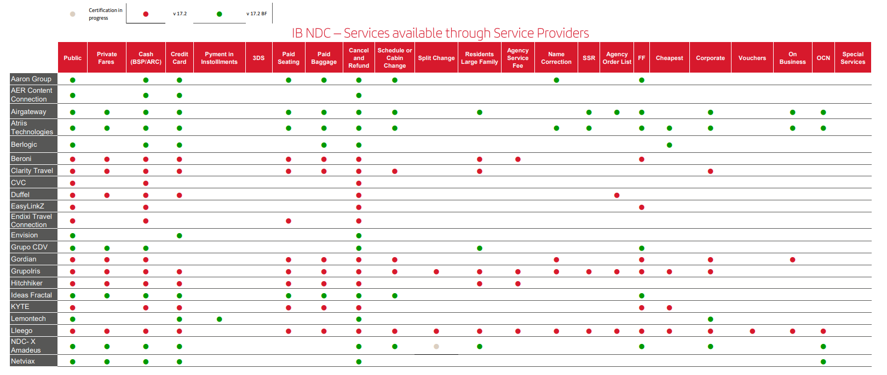
Service Providers IB NDC - Appendix I

Slide 10
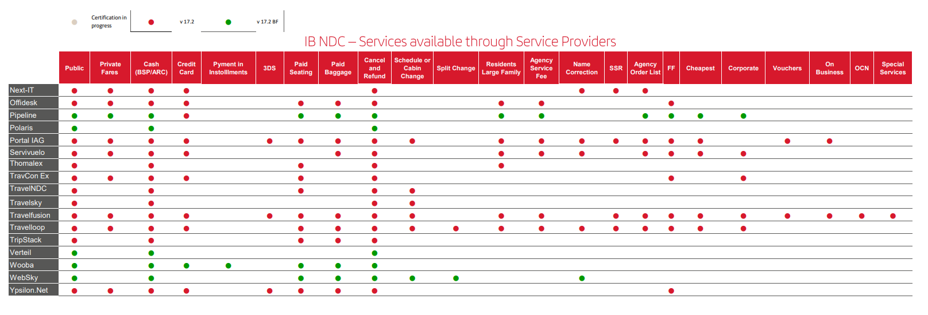
Service Providers IB NDC - Appendix I

Slide 11
Thank you!
Don't think twice. If your agency is not registered yet in the Iberia NDC, now it has the opportunity to do so and offer you all the news, offers and services that you will have available once it is registered.

